Slide 1

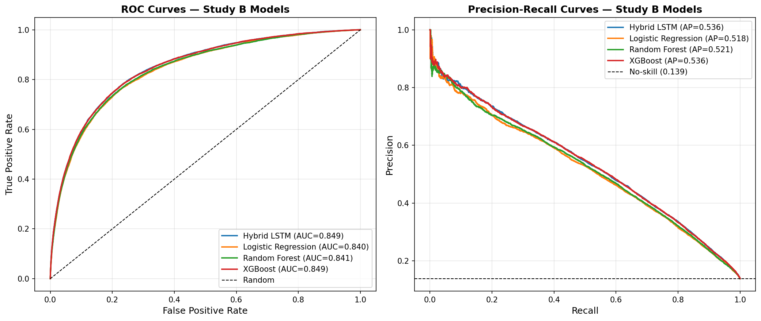
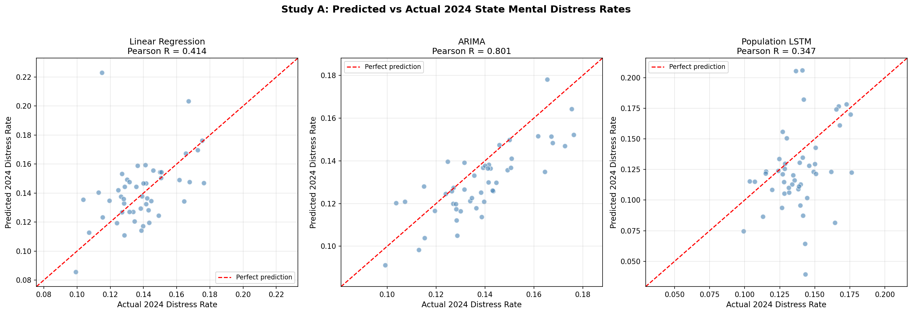
From Population Trends to Individual Risk: Predicting Frequent Mental Distress Using BRFSS Survey Data (2019–2024)
Gia Nguyen, Juan Perez, Cole Jaramillo
University of Houston
Abstract
Methods
Results
Mental health conditions represent one of the most pressing public health challenges in the United States, yet population-level early warning systems remain underdeveloped. This paper presents a dual-level predictive framework for frequent mental distress (14+ poor mental health days/30) using six years of CDC BRFSS data (2019–2024). Study A forecasts state-level distress prevalence via Population LSTM, ARIMA, and Linear Regression. Study B classifies individual-level risk using a novel Hybrid LSTM, XGBoost, Random Forest, and Logistic Regression. The Hybrid LSTM matches XGBoost on aggregate performance (AUC-ROC 0.849, PR-AUC 0.536) while achieving superior fairness across ACE burden and race subgroups.
Study A: Population-level forecasting (48 states, LOSO CV)
• Input: state-year panel, 24 features, 2019–2023 → predict 2024 prevalence
• Models: Linear Regression baseline | ARIMA | Population LSTM (2-layer, 32→16 units)
Study B :Individual-level classification (2024 BRFSS, n ≈ 450,000)
• Novel Hybrid LSTM: ACE variables as ordered 11-item sequence (LSTM stream, 64 units) + 56 static features (dense stream) → merged representation
• Baselines: Logistic Regression | Random Forest | XGBoost
• Evaluation: AUC-ROC, PR-AUC (primary); fairness disaggregated by race, income, ACE burden
Study B
• All models achieve strong discrimination: AUC-ROC 0.840–0.849, PR-AUC 0.518–0.536
• Hybrid LSTM matches XGBoost exactly (AUC 0.849, PR-AUC 0.536)
Key finding: Hybrid LSTM has smallest AUC gap between High vs. Low ACE groups (0.026 vs. XGBoost's 0.029), and best fairness across racial subgroups
The Hybrid LSTM matches XGBoost exactly on both primary metrics. More importantly, it achieves the smallest AUC performance gap between High ACE (≥4) and Low ACE (0–3) respondents (0.026 vs. XGBoost's 0.029), and the most consistent performance across racial subgroups- supporting the core hypothesis that sequence-aware modeling of ACE adversity captures cumulative patterns that a flat feature vector misses. A persistent race-based AUC gap (0.034–0.038 disadvantaging Black and Other/Multiracial respondents) was consistent across all models, indicating a data-level feature representation limitation rather than a modeling artifact.
Background
Results
Mental health disorders affect approximately one in five U.S. adults annually, yet surveillance systems continue to rely on slow, retrospective reporting mechanisms poorly suited to proactive intervention. Frequent mental distress -defined by the CDC as 14 or more poor mental health days in the past 30- affects an estimated 13 to 14% of U.S. adults and serves as a key indicator in national public health monitoring.
The CDC's BRFSS is the largest annual health survey in the U.S., covering 400,000+ respondents across all 50 states. Unlike clinical datasets, BRFSS captures behavioral risk factors, social determinants of health (SDOH), chronic conditions, and since 2019, a comprehensive Adverse Childhood Experiences (ACE) module, making it an unusually rich source for mental health prediction.
Despite this, no prior work has (1) applied temporal LSTMs to multi-year BRFSS state aggregates, (2) framed ACE variables as a sequential input to a recurrent network, or (3) combined population- and individual-level modeling into a unified dual-study framework for mental health prediction. This paper addresses all three gaps.
Study A
• ARIMA outperforms Population LSTM (MAE 0.0116, R=0.801 vs. MAE 0.0259, R=0.347)
• LSTM underperformance expected: only 47 training sequences per LOSO fold
• Geographic insight: Oregon (17.6%), Louisiana (17.5%), Arkansas (17.3%) show highest 2024 distress; Massachusetts alone recovers below COVID peak
A secondary geographic analysis revealed meaningful heterogeneity: Oregon (17.6%), Louisiana (17.5%), and Arkansas (17.3%) posted the highest 2024 distress rates, while Massachusetts was the only state to recover meaningfully below its COVID-era peak. Western states showed the largest COVID-era spikes (2019–2021), while Southern states show persistently elevated rates driven by pre-existing structural SDOH conditions rather than pandemic dynamics.
Conclusion
A dual-level predictive framework using BRFSS data successfully identifies frequent mental distress at both population and individual scales. While ARIMA dominates in the data-scarce state-level setting, the Hybrid LSTM demonstrates that sequence-aware modeling of ACE adversity yields both competitive accuracy and meaningful fairness advantages, particularly for high-ACE individuals.
Together, the two studies establish a replicable dual-level surveillance framework that could inform resource allocation, targeted screening programs, and policy intervention. The results reinforce that cumulative childhood adversity, modeled as a sequence rather than a flat count, offers both predictive and equity benefits for mental health screening.
Future Direction
• Subgroup-specific threshold recalibration to improve precision-recall balance across income and race groups
• Expand feature set with immigration status, neighborhood-level, and discrimination-related variables to close race-based AUC gap
• County-level BRFSS estimates or finer temporal resolution to better leverage Population LSTM capacity
• Prospective validation on 2025+ BRFSS waves

